Slide 1
CHAPTER 5
FLOWCHARTS

Slide 2

OBJECTIVES FOR TODAY
Understand the graph flows symbols
Be able to express an algorithm with graph flows

Slide 3


ENGAGE
Link each bloc to its symbol
5 MIN
START the program
INPUT a value
OUTPUT on console
DECIDE something
PROCESS something
STOP the program

Slide 4
CORRECTION
Link each bloc to its symbol
START the program
INPUT a value
OUTPUT on console
DECIDE something
PROCESS something
STOP the program

Slide 5
ACTIVITY
START
5 MIN
Get X
6
1 – What will this algorithm print?
2 – Convert it in Python
No
X < 7 ?
Yes
Print GOOD
Print BAD
END

Slide 6
ACTIVITY
START
5 MIN
Get X
6
1 – What will this algorithm print?
GOOD
2 – Convert it in Python
X = int(input())
if x <7 :
print (“GOOD”)
else :
print (“BAD”)
No
X < 7 ?
Yes
Print GOOD
Print BAD
END

Slide 7
ACTIVITY
START
5 MIN
Get X
6
1 – What will this algorithm print?
2 – Convert it in Python
No
X < 7 ?
Yes
Print GOOD
Print BAD
END

Slide 8
ACTIVITY
START
5 MIN
Get X
6
1 – What will this algorithm print?
GOOD
GOOD
GOOD
(no end)
2 – Convert it in Python
X = int(input())
while x <7 :
print (“GOOD”)
print (“BAD”)
No
X < 7 ?
Yes
Print GOOD
Print BAD
END

Slide 9
ACTIVITY
START
5 MIN
Get X
6
1 – What will this algorithm print?
2 – Convert it in Python
No
X < 7 ?
Yes
Print GOOD
Print BAD
X = X +1
END

Slide 10
ACTIVITY
START
5 MIN
Get X
6
1 – What will this algorithm print?
GOOD
BAD
2 – Convert it in Python
X = input()
while x <7 :
print GOOD
x = x +1
print BAD
No
X < 7 ?
Yes
Print GOOD
Print BAD
X = X +1
END

Slide 11
ACTIVITY
START
5 MIN
Get X
4
1 – What will this algorithm print?
2 – Convert it in Python
No
X > 0 ?
Yes
Print GOOD
X = X - 1
END

Slide 12
ACTIVITY
START
5 MIN
Get X
4
1 – What will this algorithm print?
GOOD
GOOD
GOOD
GOOD
2 – Convert it in Python
X = input()
while x>0:
print GOOD
x = x -1
print BAD
No
X > 0 ?
Yes
Print GOOD
X = X - 1
END

Slide 13
ACTIVITY
START
5 MIN
Get X
6
1 – What will this algorithm print?
2 – Convert it in Python
Done
REPEAT 4 TIMES
Ongoing
Print X
Print BYE
END

Slide 14
ACTIVITY
START
5 MIN
Get X
6
1 – What will this algorithm print?
6
6
6
6
2 – Convert it in Python
X = input()
for _ in range(4) :
print X
print BYE
Done
REPEAT 4 TIMES
Ongoing
Print X
Print BYE
END

Slide 15
ACTIVITY
START
5 MIN
Get age
12
Describe what will happen
With this program
Get grade
30
No
Age <15 ?
Will I get a job ?
REPEAT 4 TIMES
Yes
Study in Hight school
Study at PNC
Age ++
No
Grade > 50
Yes
Get a job
END

Slide 16
EXPLAIN
THE FOR
THE IF
THE WHILE
No
Done
No
A > B ?
REPEAT 5
A > B ?
Yes
Yes
for _ in range(5):
Do something
if A>B:
Do something
Else
Do something
while A>B:
Do something

Slide 17
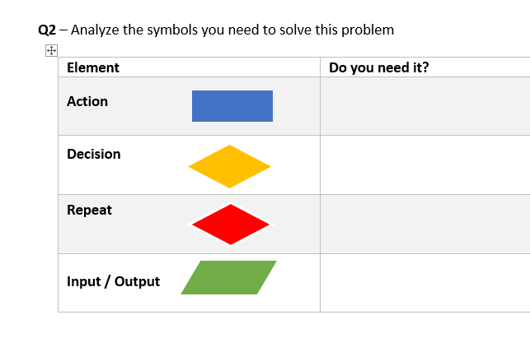
ACTIVITY
EXERCICES
30 MIN
Perform the exercises individually on paper

